Slide 1
Introduction to Finance
Concept of Finance
Finance Functions
The financial Goals
Finance in Organizational Structure
Finance and Related Disciplines

Slide 2
Introduction
Financial Management is concerned with management of funds in context of business
Finance
For example: If one big project is to be estimated, what sort of financial decision might be involved:
Public (management of funds of government)
Private (Personal)
(Funds of individual)
Business (decision making on managerial decision, investment decision and asset management decision

Slide 3
Continue…
1st : Estimate cost and benefit and make capital expenditure decision (Investment decision)
2nd : Manage funds for expenditure ( financing decision)
3rd: Management of acquired assets (Assets management decision)
Financial management is concerned not only with the financing decision but also with investment and assets management decision
Financial Management is the decision making process on investment, financing, dividend and current assets management decision of a corporation.
Financial management is concerned with procurement of funds from least costly sources of financing and their effective and efficient allocation into productive use.

Slide 4
Importance of Financial Management
1. Coping with ever changing market segments
(merger, liquidation, takeover, IPO, FPO)
2. Undertaking Correct Investment Decision
estimating cost benefit,
selection of best and
maximization of wealth
3. Undertaking Correct Financing Decision
Debt or Equity ( if debt: long term or short term)
Minimize cost and maximize the wealth
4. Efficient working capital Management
(investment on inventory, receivable and other liquid assets)
5. Optimal Dividend Policy Decision
which form (cash or stock) and timing of dividend

Slide 5
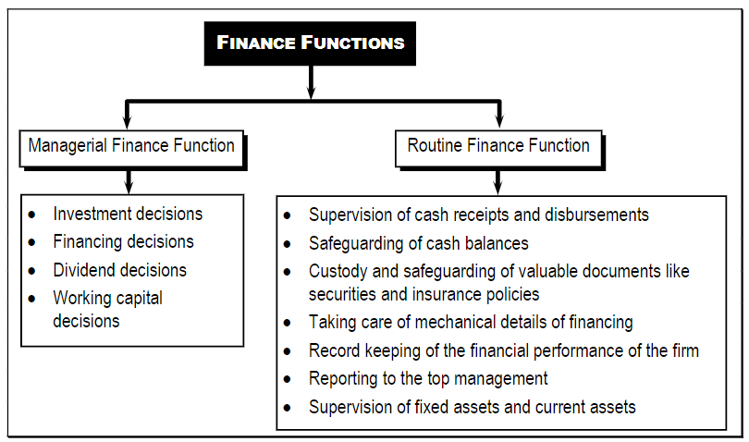
Finance Functions

Slide 6
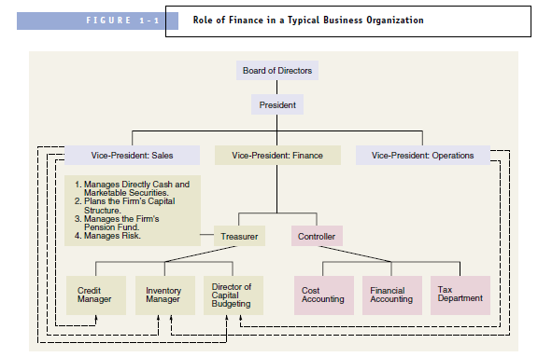
Finance with in an organization

Slide 7
Goals of Financial Management
Goals are the purpose for which finance functions are carried out
Profit maximization Goal
Action that increase profit should be undertaken and those that decrease profit are to be avoided
Favor of Profit Maximization:
Profit is test of economic efficiency
Effective utilization of scare economic resources
Leads to total economic welfare
Criticism of Profit Maximization
Ambiguity (PAT or EBIT ; short term or long term, gross or net)
e.g issuing share and using proceeds in Treasury Bills can maximize profit but result decrease in EPS
Ignores Time value of money
Ignore Quality of Benefits
Unsuitable in Modern Business Environment (increase conflict among stakeholders

Slide 8
Goals of Financial Management
2. Value Maximization Goal
Managers should take decision that maximize the shareholder’s wealth
Project should generate positive Net Present Value (NPV = PV benefit – PV of cost)
Arguments in favor of wealth maximization:
Goal is clear (cost and benefit measured in terms of cash flow)
Consider Timing of cash flow
Consider quality of benefits (quality refers to certainty of cash flow)
Reduce conflict of Interest among stakeholders of firm. How
Allocate scare resources efficiently
Requires low cost business and high quality goods and services
Creditors must be paid before anything to be paid to stockholders
Employees are fairly compensated

Slide 9
Relationship between Profit Maximization and Stock Price Maximization
Maximization of profit is an important variable but it alone does not necessarily maximize the stock price in the stock market.
Other Variables Like:
Prospects of Dividends
Growth of Dividends
Investment opportunities and risk in firm
Quality of management
Also plays important role in the maximization of stock price

Slide 10
Finance and Related Disciplines
Relationship with Economics
Relationship with Accounting
Relationship with other disciplines
Mathematics
Quantitative Techniques
Statistics

